Slide 2
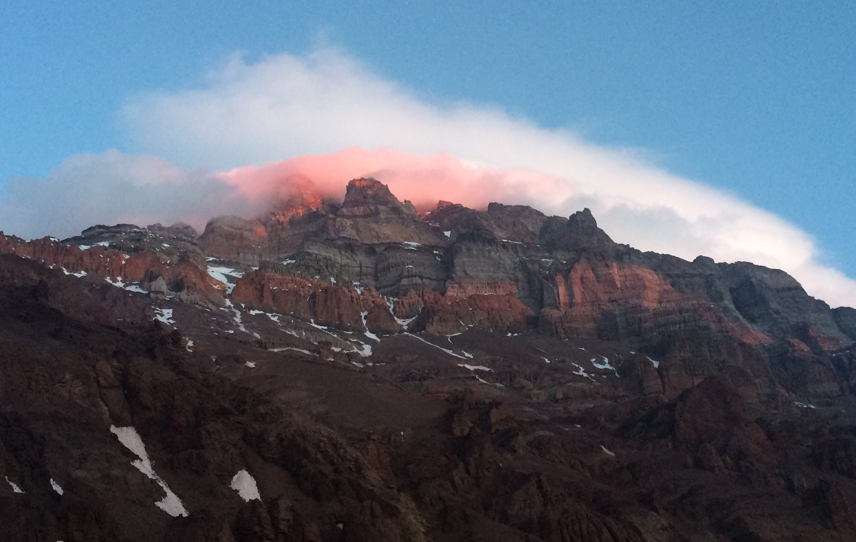
Aconcagua
Elevation 22,841’

Slide 3
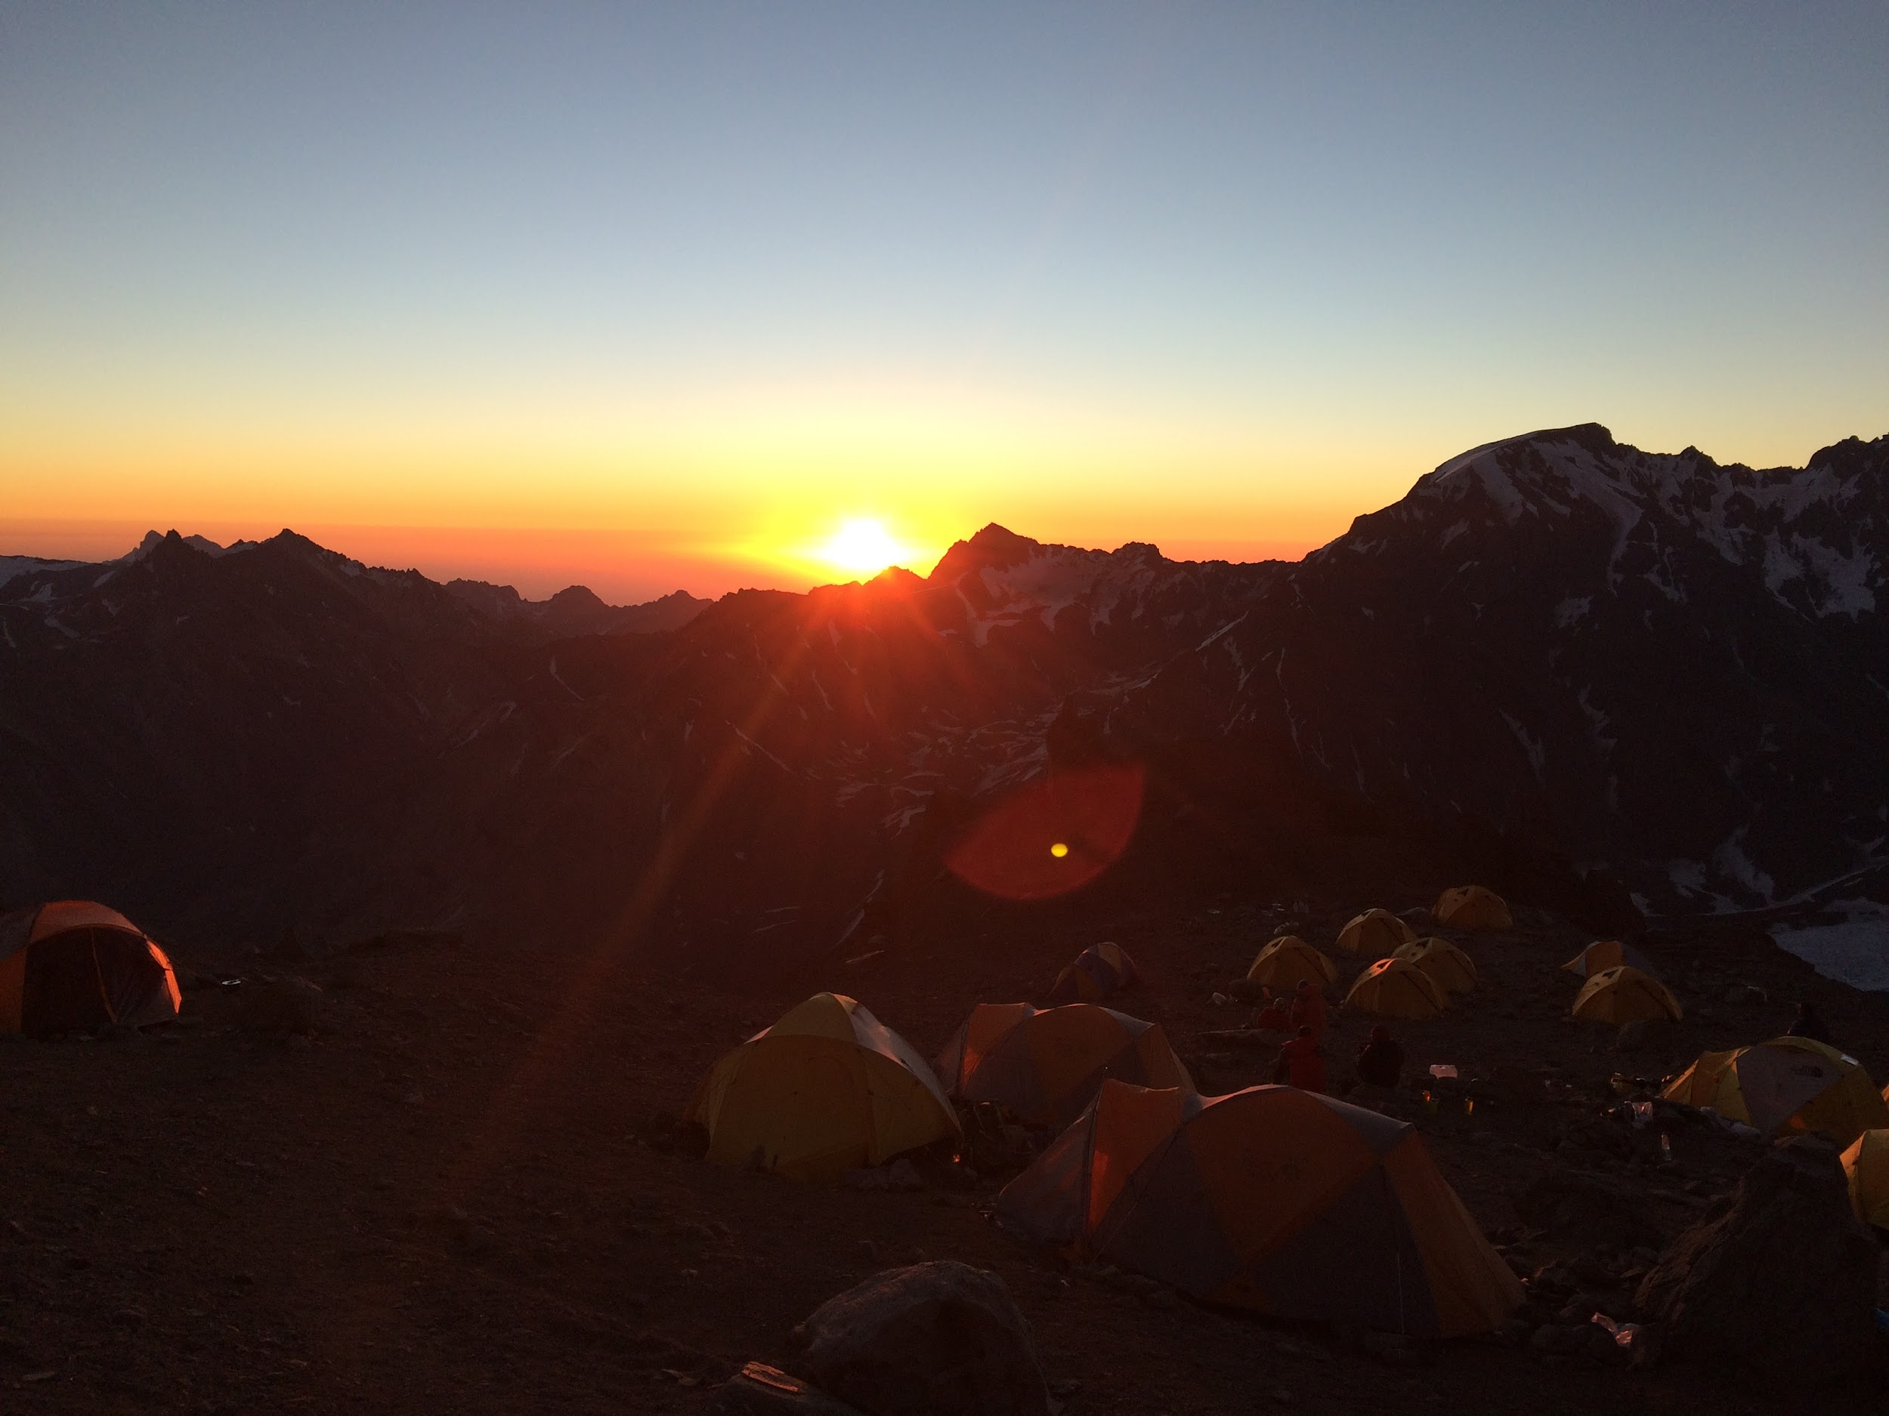

Slide 5
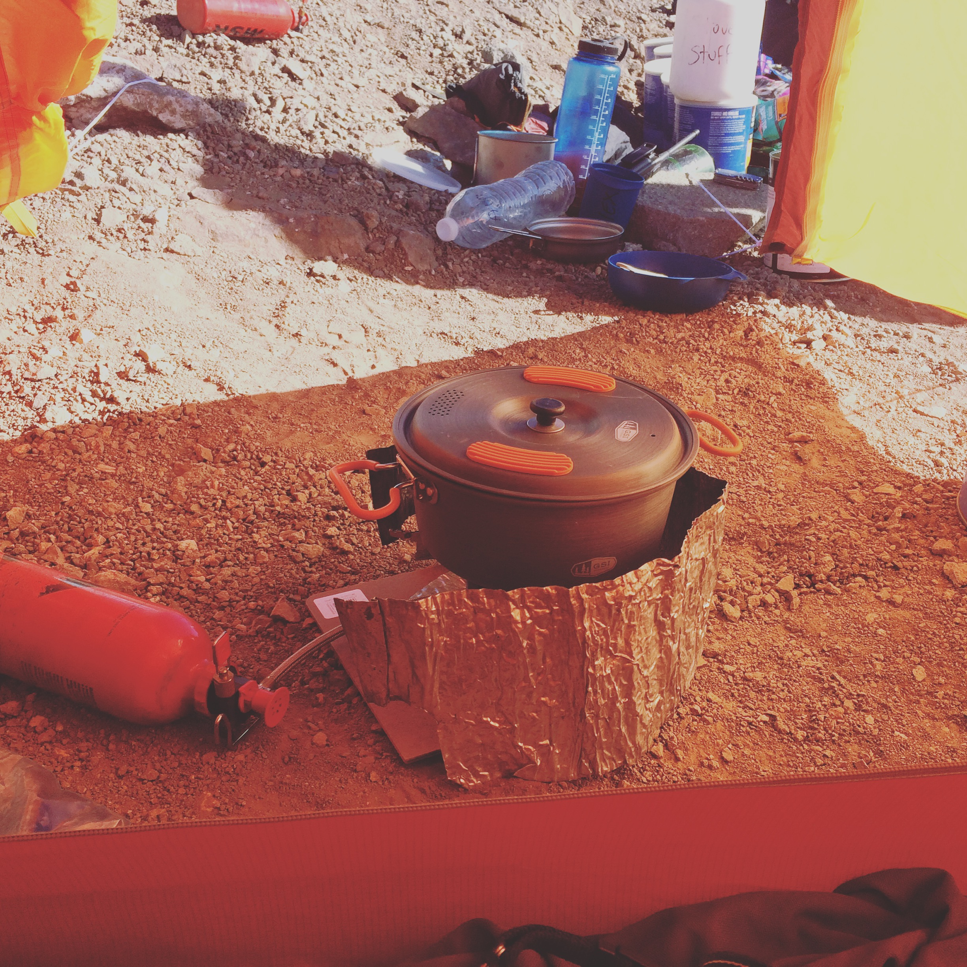

Slide 7
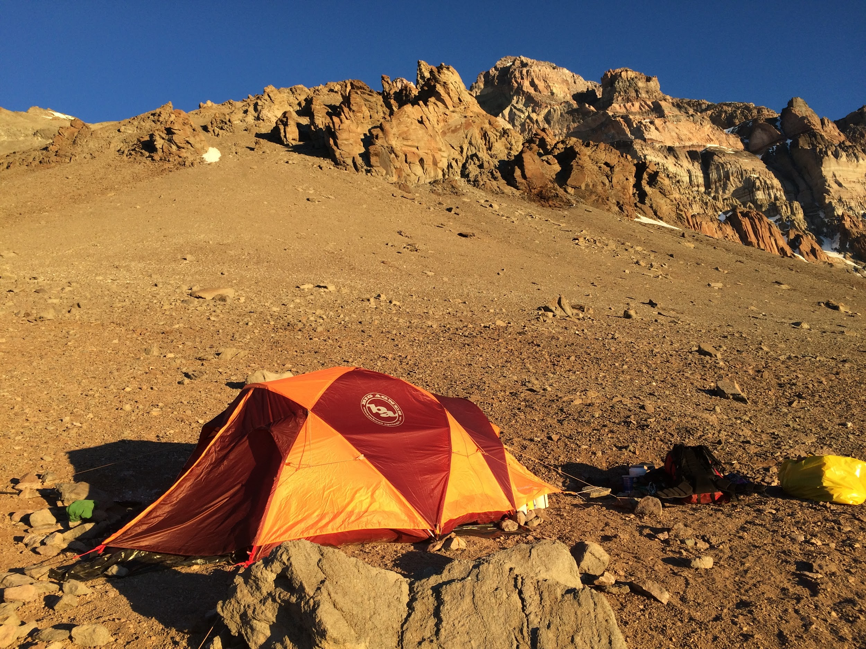

Slide 9
The Book
THE STAFF

Slide 10
Rev 12:11 And they overcame him by the blood of the Lamb, and by the word of their testimony; and they loved not their lives unto the death.
Active Ongoing Relationship with God creates a STORY that will LIVE forever.

Slide 11
Let’s Go!

Slide 13
Jesus
is good for
BUSINESS

Slide 14
Papa JL
Real Estate

Slide 15
Luke 5
One day as Jesus was standing by the Lake of Gennesaret, the people were crowding around him and listening to the word of God. 2 He saw at the water’s edge two boats, left there by the fishermen, who were washing their nets. 3 He got into one of the boats, the one belonging to Simon, and asked him to put out a little from shore. Then he sat down and taught the people from the boat.
4 When he had finished speaking, he said to Simon, “Put out into deep water, and let down the nets for a catch.”
5 Simon answered, “Master, we’ve worked hard all night and haven’t caught anything. But because you say so, I will let down the nets.”
6 When they had done so, they caught such a large number of fish that their nets began to break. 7 So they signaled their partners in the other boat to come and help them, and they came and filled both boats so full that they began to sink.
8 When Simon Peter saw this, he fell at Jesus’ knees and said, “Go away from me, Lord; I am a sinful man!” 9 For he and all his companions were astonished at the catch of fish they had taken, 10 and so were James and John, the sons of Zebedee, Simon’s partners.
Then Jesus said to Simon, “Don’t be afraid; from now on you will fish for people.” 11 So they pulled their boats up on shore, left everything and followed him.

Slide 16
Josephus -230 boats-
Peter/James/John - Partners
Jesus didn’t ask to get into the boat.
CAN JESUS INVADE ANY ASPECT OF YOUR LIFE?
Peter followed the instruction, allowed use of the boat.
MADE ROOM for JESUS
Time passed during Jesus teaching.
PATIENCE
Jesus gave instruction and it didn’t make sense.
OBEDIENCE
The catch exceeded their CAPACITY.
OVERFLOW
“From now on, you’ll be fishing for people.”
They left everything and followed Jesus.

Slide 17
John 21
Afterward Jesus appeared again to his disciples, by the Sea of Galilee. It happened this way: 2 Simon Peter, Thomas (also known as Didymus), Nathanael from Cana in Galilee, the sons of Zebedee, and two other disciples were together. 3 “I’m going out to fish,” Simon Peter told them, and they said, “We’ll go with you.” So they went out and got into the boat, but that night they caught nothing.
4 Early in the morning, Jesus stood on the shore, but the disciples did not realize that it was Jesus.
5 He called out to them, “Friends, haven’t you any fish?” “No,” they answered.
6 He said, “Throw your net on the right side of the boat and you will find some.” When they did, they were unable to haul the net in because of the large number of fish.
7 Then the disciple whom Jesus loved said to Peter, “It is the Lord!” As soon as Simon Peter heard him say, “It is the Lord,” he wrapped his outer garment around him (for he had taken it off) and jumped into the water. 8 The other disciples followed in the boat, towing the net full of fish, for they were not far from shore, about a hundred yards. 9 When they landed, they saw a fire of burning coals there with fish on it, and some bread.
10 Jesus said to them, “Bring some of the fish you have just caught.” 11 So Simon Peter climbed back into the boat and dragged the net ashore. It was full of large fish, 153, but even with so many the net was not torn. 12 Jesus said to them, “Come and have breakfast.” None of the disciples dared ask him, “Who are you?” They knew it was the Lord. 13 Jesus came, took the bread and gave it to them, and did the same with the fish. 14 This was now the third time Jesus appeared to his disciples after he was raised from the dead.

Slide 18
Jesus appeared on the shore at Dawn. 100Yds
Jesus met them with Fire, Food & Fellowship
Told them WHERE to Fish
The net was FULL
The FISH were LARGE
The net didn’t BREAK
“Follow Me”
Business/Business Miracles in the midst of KINGDOM WORK
NATURAL is a reflection of what you’re called to do in the SPIRIT. It’s a BIG CLUE!!

Slide 19
Jesus

Slide 20
1 What’s on HIS mind?
2 Where is HE going?
3 Am I going with HIM?

Slide 21
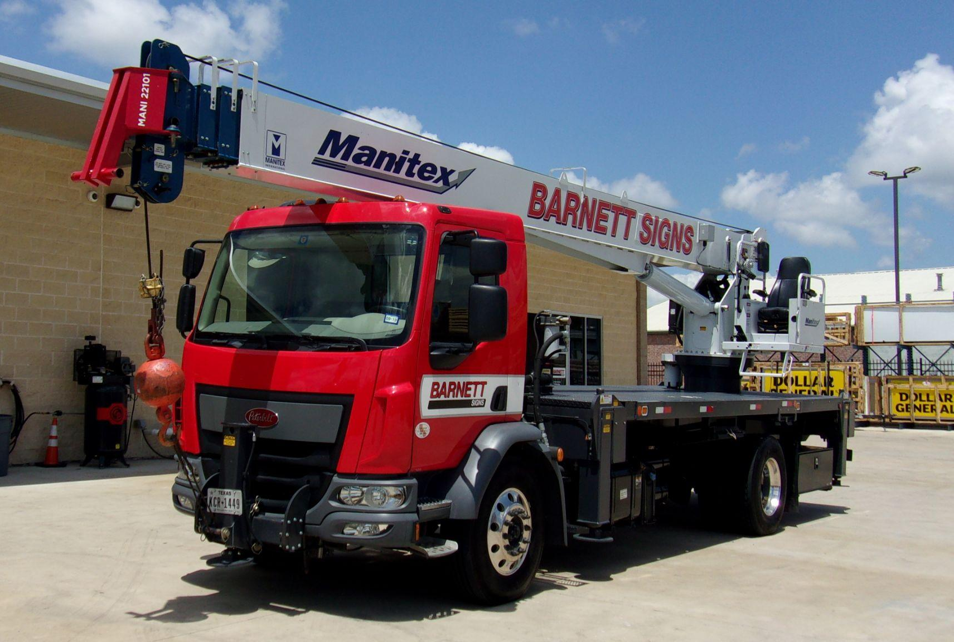
Impossible

Slide 22
When did you meet Jesus?
Where do you spend the majority of your week?

Slide 24
Kingdom
CAMP

Slide 25
What is the Gospel of the KINGDOM?

Slide 26
Matt. 3
1 In those days John the Baptist came preaching in the wilderness of Judea, 2 and saying,
“Repent, for the kingdom of heaven is at hand!”

Slide 27
Matt. 4
17 From that time Jesus began to preach and to say,
“Repent, for the kingdom of heaven is at hand.”

Slide 28
God is ready to take over the GOVERNMENT of the Human Race.
KINGDOM!

Slide 29
Isaiah 9
6 For a child is born to us, a son is given to us.
The government will rest on his shoulders. And he will be called: Wonderful Counselor, Mighty God,
Everlasting Father, Prince of Peace.
7 His government and its peace will never end.
He will rule with fairness and justice from the throne of his ancestor David for all eternity.
The passionate commitment of the Lord of Heaven’s Armies will make this happen!

Slide 30
Matt. 6
“‘Our Father in heaven, hallowed be your name,
10 your kingdom come, your will be done,
on earth as it is in heaven.

Slide 31
Russ - Back
Billy - Shock
Jeremy - Hiring

Slide 32
Gospel of Salvation
FUTURE ETERNAL LIFE
(Family of God)

Slide 33
Gospel of Salvation
FUTURE ETERNAL LIFE
(Family of God)
Gospel of the KINGDOM

Slide 34
Gospel of Salvation
FUTURE ETERNAL LIFE
Jesus
Gospel of the KINGDOM
=
CALLED NOW!

Slide 35
Jesus

Slide 36
Jesus
Jesus

Slide 37
Suspended
& Stuck
Jesus
Jesus

Slide 38
Jesus
Jesus
Step

Slide 39
Jesus
Jesus

Slide 40
1 Cor 4
20 For the kingdom of God is not a matter of talk but of power.

Slide 41
Need
Side
Supply
Side
Jesus
Jesus

Slide 42
Romans 14
17 For the kingdom of God is not a matter of eating and drinking, but of righteousness, peace and joy in the Holy Spirit,.....

Slide 43
Jesus
Jesus

Slide 44
Come under
the Government of King Jesus
Some people are saved, but become something other than what God intended.

Slide 45
IDENTITY
Suspended
Jesus
Jesus

Slide 46
Opportunity
Suspended
Jesus
Jesus

Slide 48
Camp
Navigator

Slide 49
Government
Media
Religion
Arts
Family
Education
Business

Slide 50
Business
Family
Business
Religion
Business
Religion

Slide 51
Government
Media
Religion
Arts
Family
Education
Business

Slide 52
Religion
Gospel of Salvation

Slide 53
Wait It Out
Best Day of the Week
Could Have Been a Shoe Salesman
Religion
Gospel of Salvation

Slide 54
Government
Media
Religion
Arts
Family
Education
Business
Gospel of the KINGDOM

Slide 56
CAMP
Calling

Slide 57
Calling
Way of Life

Slide 58
2 Timothy 1
9 He has saved us and called us to a holy life—not because of anything we have done but because of his own purpose and grace. This grace was given us in Christ Jesus before the beginning of time…..

Slide 59
2 Timothy 1
9 He has saved us and called us to a holy life—not because of anything we have done but because of his own purpose and grace. This grace was given us in Christ Jesus before the beginning of time…..
If you’re SAVED,
you’re also CALLED.

Slide 60
Government
Media
Religion
Arts
Family
Education
Business

Slide 61
Romans 8
28 And we know that in all things God works for the good of those who love him, who have been called according to his purpose. 29 For those God foreknew he also predestined to be conformed to the image of his Son, that he might be the firstborn among many brothers and sisters. 30 And those he predestined, he also called; those he called, he also justified; those he justified, he also glorified.

Slide 62
1 Peter 1
18 For you know that it was not with perishable things such as silver or gold that you were redeemed from the empty way of life handed down to you from your ancestors, 19 but with the precious blood of Christ, a lamb without blemish or defect.

Slide 63
1 Peter 1
18 For you know that it was not with perishable things such as silver or gold that you were redeemed from the empty way of life handed down to you from your ancestors, 19 but with the precious blood of Christ, a lamb without blemish or defect.
Sacred = Connected to God

Slide 64
1 Peter 1
18 For you know that it was not with perishable things such as silver or gold that you were redeemed from the empty way of life handed down to you from your ancestors, 19 but with the precious blood of Christ, a lamb without blemish or defect.
Sacred = Connected to God
“Full Time Ministry”

Slide 65
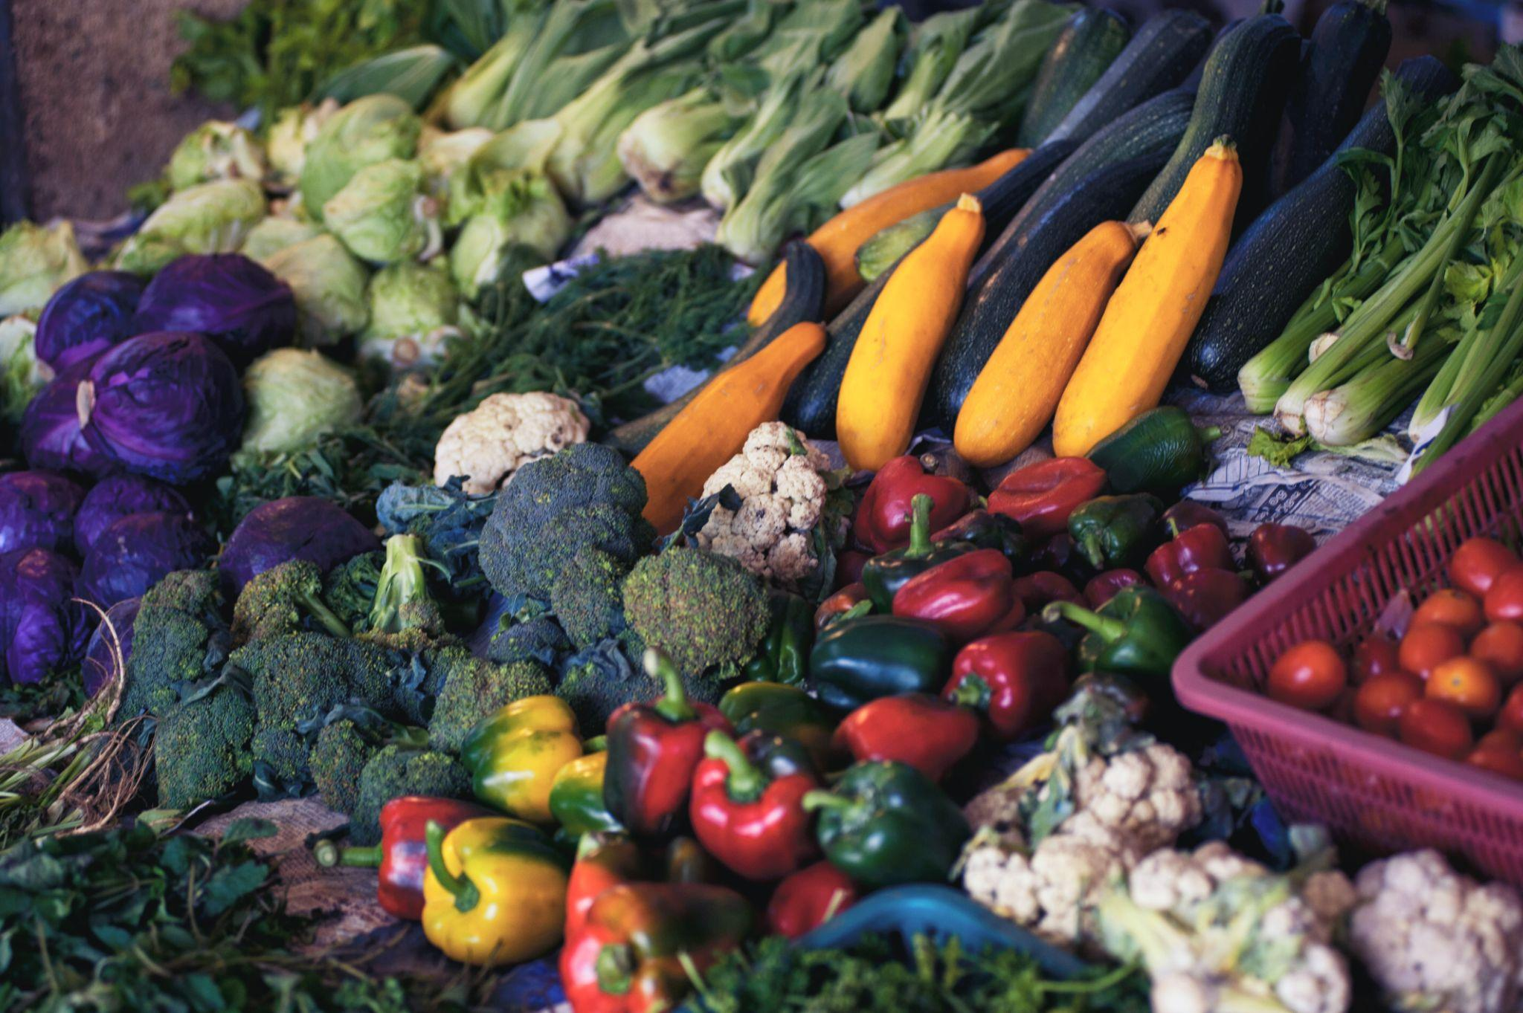

Slide 66
Ephesians 5
1 Imitate God, therefore, in everything you do, because you are his dear children.

Slide 67
Ephesians 5
1 Imitate God, therefore, in everything you do, because you are his dear children.
Imitate the Last Adam
King, Priest, Prophet

Slide 68
We don’t decide what
TO DO, we have to find what HE has PREPARED!

Slide 69
We don’t decide what
TO DO, we have to find what HE has PREPARED!
The BOOK!

Slide 70
Find Your Call
1 Give your bodies to God.
2 Yield to God’s Transformation, gives way to “Will”.
3 Be Realistic…Faith determines what you’ll do.
4 Finding your place..finding your place in the Body.
5 When you find your place, you find your gifts.

